Slide 1
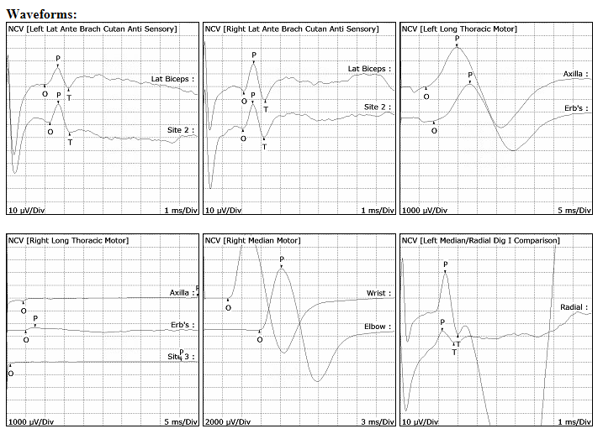
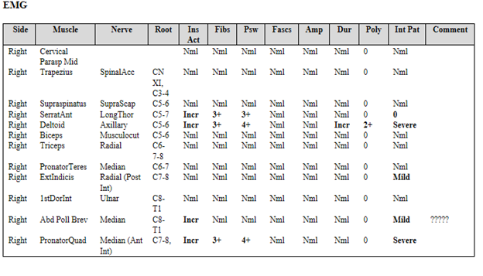
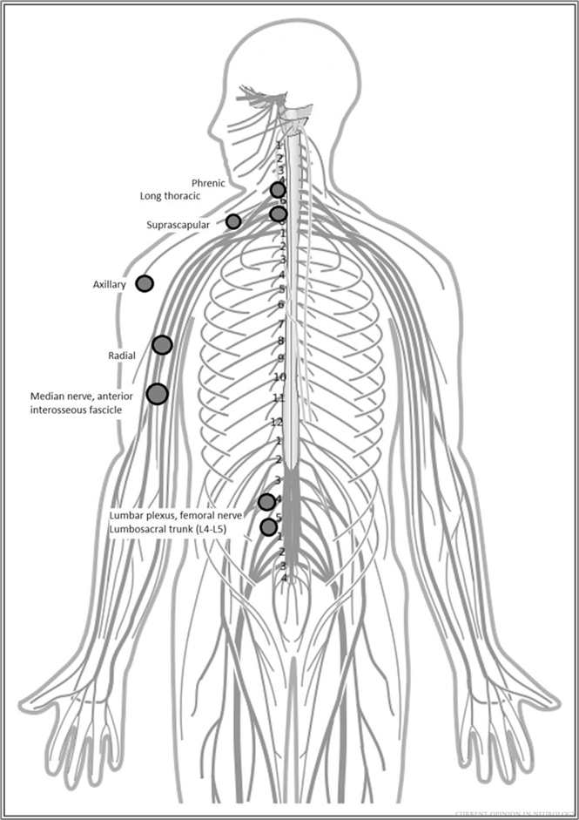
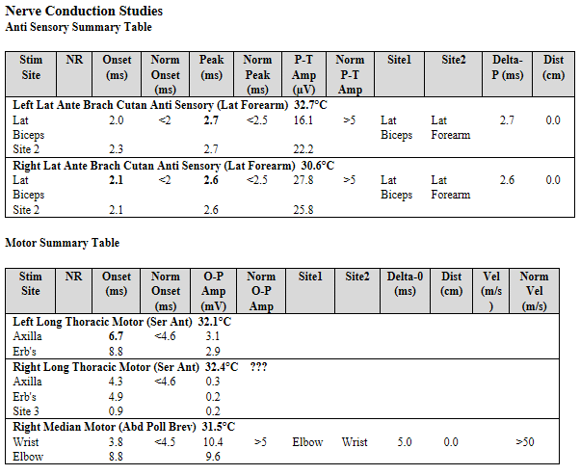
Neuralgic Amyotrophy Following Alcohol Withdrawal Seizure:
A Case Report
Annika Eveland MD, Paul Brockman MD
Reading Hospital - Tower Health, West Reading PA
Case Description: A 34-year-old male was hospitalized in mid-January 2022 with alcohol withdrawal seizures. In the beginning of February 2022 he experienced right arm pain, numbness and weakness. Shoulder x-ray was unremarkable. On exam he had right scapular winging and weakness of right shoulder abduction with deltoid atrophy. Electrodiagnostic testing was compatible with neuralgic amyotrophy with acute injury to 3 segments of the brachial plexus involving long thoracic, axillary and anterior interosseous nerves. Serological workup, cervical spine and brachial plexus MRI were unremarkable.
Discussion: Neuralgic Amyotrophy, also known as Parsonage-Turner syndrome, is a rare disorder with an incidence of 1.64 per 100,000 individuals [2]. It is characterized by sudden upper extremity pain followed by weakness, sensory disturbance and muscle atrophy [1]. It is believed to be auto-immune in nature and can be triggered by infection, vaccination, immunotherapy, recovery from surgery, pregnancy, trauma or psychological distress [3]. This is the first case to our knowledge of neuralgic amyotrophy following alcohol withdrawal seizure.
A graphic overview of the most commonly affected nerve sites in neuralgic amyotrophy
Conclusion: Neuralgic amyotrophy is a rare inflammatory neuropathy that can occur in response to a preceding stressful event, including alcohol withdrawal seizure.
References
1.Bauer TW, Resnick L. Parsonage-Turner syndrome antecedents may not be causes. JBJS Case Connect 2022;12(1).
2. Carrier RE, Marchetti MP. Parsonage-Turner syndrome of unclear causation: a case report. Cureus 2022;14(7).
3. Ijspeert J, Janssen RM, van Alfen N. Neuralgic amyotrophy. Curr Opin Neurol 2021;34(5):605-12.

