Slide 1
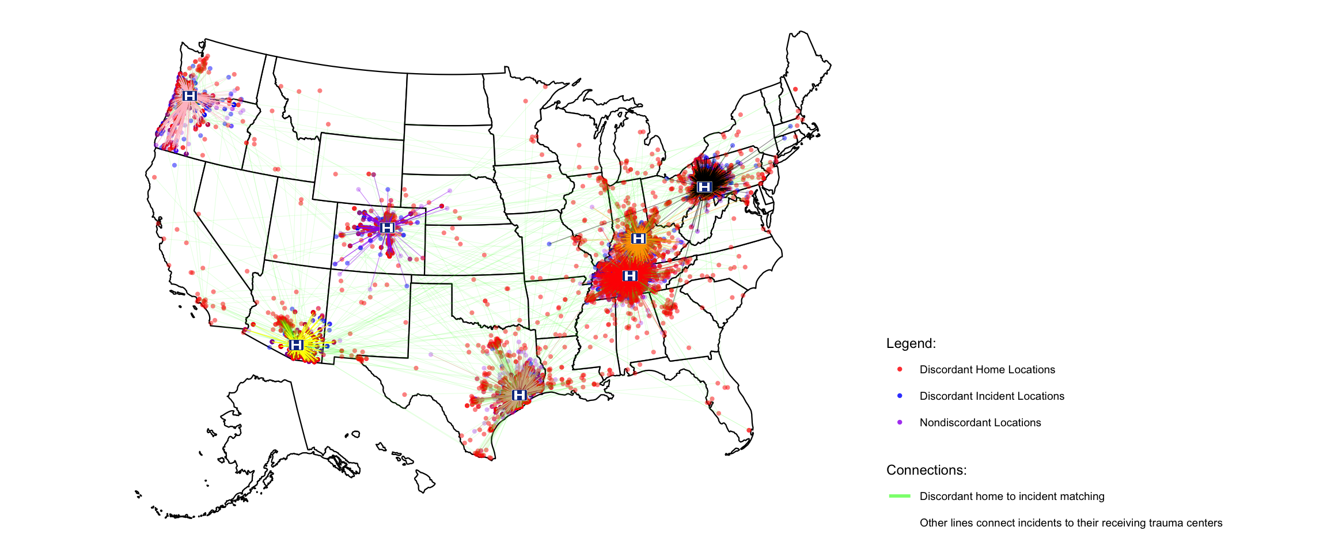
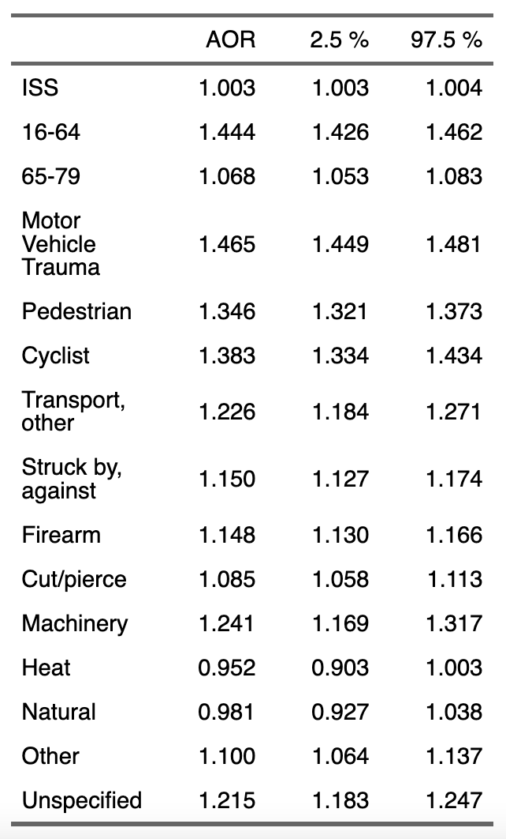
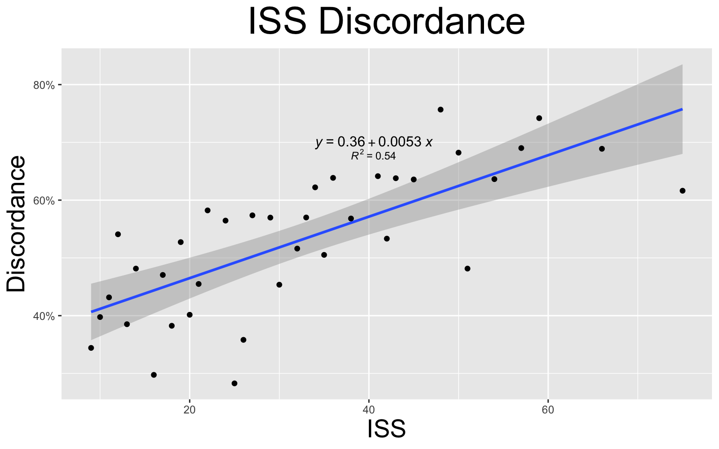
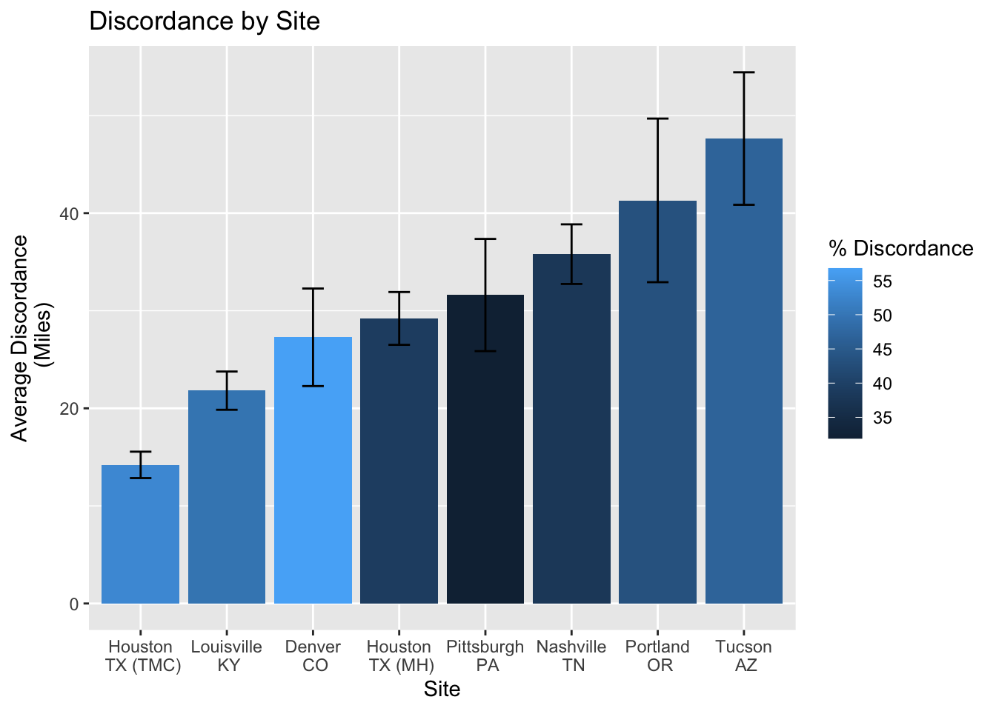
How close is close enough: home as a proxy for incident location in trauma systems
Jamison Beiriger^{1,2}, David Silver², Liling Lu², Joshua Brown²
1: Drexel University College of Medicine
2: University of Pittsburgh Medical Canter Department of Surgery
Introduction
Results
Discussion
Trauma is one of the most prominent causes of mortality in the United States contributing to over 3 million injuries and 150,000 fatalities annually, many of which are preventable. Trauma systems are intended to mitigate the harms of trauma, while maximizing outcomes in injured patients. In trauma management, urgent treatment is critical as time to care is inversely related to mortality and functional outcomes. Trauma system organization is paramount for timely and effective response to trauma, especially in cases of severe injury.
Historically, system planning has relied on patient home location as a proxy for incident location when recording the geographic frequency of trauma. The Collaborative National Trauma Center and the Center for Disease Control fatal injury mapping applications are among such systems. The few studies that have examined this practice used different metrics and patient populations and failed to reach a consensus on the validity of the practice.
We hope to determine if there is a need for further evaluation of this practice in a moderate to severely injured subset of trauma patients.
A total of 50,175 patients transferred to 8 trauma centers were included in the analysis after application of the inclusion criteria. Home and incident zip codes were discordant in 21,635 patients (43.1%). This discordance is much higher than previously reported in other populations, conveying this population could require special attention.
Consistent with previously published studies, discordance rates were significantly affected by injury mechanism, ISS, and age. Injuries related to motor vehicles (ref: falls; AOR: 1.47; 95%CI: 1.45-1.48) were most likely to occur outside the home zip code. Also, discordance was highest in adults aged 16-64 (ref: 80+; AOR: 1.44; 95%CI: 1.43-1.46).
A strong positive linear relationship existed between ISS and discordance with every point increase in ISS corresponding with a 0.53% increase in discordance (p<0.001). This direct relationship is important to consider as trauma resources are distributed.
Discordance and distance discordant varied by site. Discordance was highest in Denver, while discordant distance was low in Denver and highest in Tucson. Zip code spatial area varies regionally and may play a role in discordant distance.
The findings warrant further critical evaluation of this practice in this population.
Methods
Secondary analysis of the Linking Investigations in Trauma and Emergency Services Task Order 1 (LITES T01) database
Inclusion:
16 years or older
Injury severity score (ISS) > 9
Both home and incident zip code available
Exclusion: (to remove imputation mistakes and travelers)
Ground Transport > 150 miles
Ground Transport > 300 miles with transfer
Air Transport > 1000 miles
Home location > 350 miles
Primary Outcome:
Relationship between home and incident location in this population of trauma patients
Secondary Outcomes:
Subgroup analysis of severity, age, and mechanism of injury effect on discordance
Subgroup analysis of trauma center (site) effect on discordance
Adjusted odds ratios (AOR) calculated using logistic regression corrected for age and sex
Reference groups: elderly (80+) and falls
Future Prospects
This study’s findings indicate the need to analyze this data with models used in trauma system planning.
Explore the regional variation in discordance and discordant distance on modeling to better understand the impact and devise appropriate solutions.
Design trauma system planning solutions that account for the most severe injuries occurring furthest from home to improve outcomes.
If the models find a significant difference between home and incident locations, determine whether some percentage of home as a proxy is sufficient for use as a hybrid variable.
Acknowledgements
I would like to thank the PRODUCTS lab at UPMC for their assistance with the study, especially Dr. Brown for his help with study design and data analysis.

