Slide 1
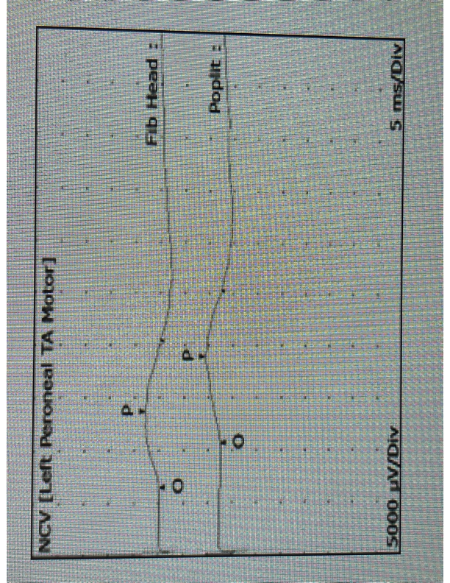
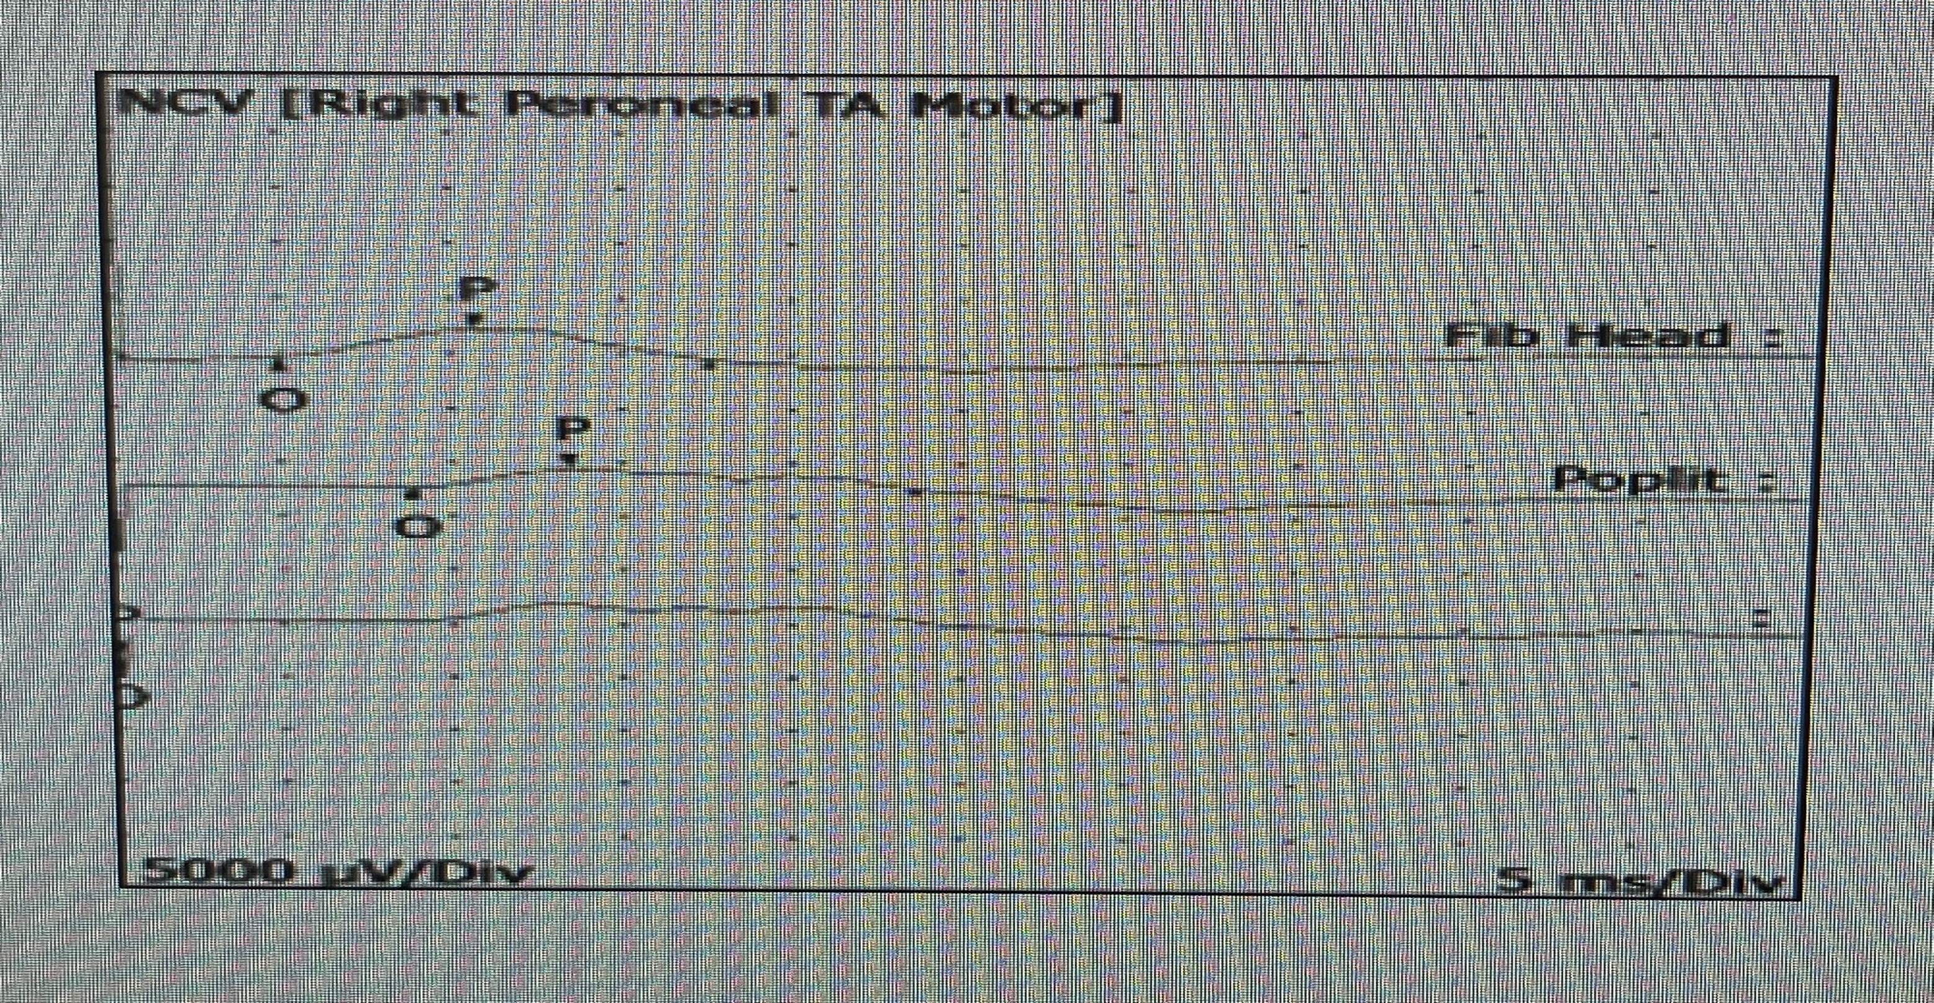
A Rare Presentation of Guillain Barre Syndrome Secondary to Pneumococcal Conjugate Vaccination
Michael Juszczak MD¹; Jedidah Prum BS²; Anishinder Parkash MD¹; William Gleason MD¹
¹Department of PM&R, Tower Health, West Reading, PA
²Drexel University College of Medicine, West Reading, PA
Introduction
Table 1
Case Description Continued: Hospital Course
Guillain Barre Syndrome (GBS) is an acute inflammatory demyelinating polyradiculoneuropathy that results in motor & sensory axonal neuropathy as well as autonomic dysfunction.
It is the leading cause of acute flaccid paralysis in developed countries worldwide.¹
GBS is a life-threatening condition with a mortality rates estimated to be as high as 7% in North America & Europe.²
Pathophysiology: Largely unknown. Believed to be an antibody immune response to infectious agents that cross react with components of peripheral nerves, resulting in degradation of Schwan cells.
Clinical Presentation: -Commonly present following viral illness affecting the GI or pulmonary systems -Rarely can be seen following vaccination. Most notably Influenza Vaccination. -Classic physical exam finding of rapidly ascending flaccid paralysis.
Prognosis: 77% of patients are ambulatory after 6 months, with 82% of patients being ambulatory at 1 year post treatment.³
Conduction Site (Nerve/Muscle) | Measured Velocity (m/s) | Normal Velocity (m/s)
L Peroneal/Ext Dig Brev | 26 | >40
R Peroneal/Ext Dig Brev | 18 | >40
L Peroneal/Tib Ant | 21 | >40
R Peroneal/Tib Ant | 23 | >40
On day 1/5 of plasmapheresis treatment, she became increasingly tachypneic ultimately resulting in acute hypoxemic respiratory failure requiring transfer to the ICU where she was started on BiPAP.
On day 3/5 of plasmapheresis treatment, her respiratory status improved, and she was transitioned off BiPAP.
After completing 5 days of plasmapheresis treatment her weakness improved and she was transferred to Reading’s Post Acute Care Rehabilitation Hospital.
Nerve Conduction Studies completed 8 weeks following discharge from acute rehabilitation showed electrophysiological evidence of demyelinating neuropathy consistent with patient’s history of GBS. See Table 1, Figure 1, Figure 2.
Figure 1
Discussion
The infrequency with which GBS is encountered following vaccination makes it an arduous diagnostic challenge.
Appropriate vaccinations should be encouraged with all patients.
The Vaccine Adverse Event Reporting System (VAERS) is co-sponsored by the CDC and FDA and is a platform that can be utilized to report adverse effects associated with all vaccines available to the public.
Adverse effects related to vaccination should continue to be reported to the VAERS so that we can better understand the immunogenic mechanisms that may play a role in genetically susceptible individuals that receive conjugate vaccines.
Methods
This case report is devoid of identifiable patient information and therefore is exempt from IRB review requirements consistent with the institution’s guidelines.
Case Description
Conclusions
A 49 year old female with a PMHx of SLE presented with diarrhea, generalized weakness, and dysesthesias in her extremities 2 weeks after receiving the pneumococcal conjugate vaccine. She denied any recent illnesses or travel.
CT scan of her brain/spine was unremarkable, and she was instructed to follow up a neurologist in 2 weeks.
She returned 1 week later with worsening weakness which caused her to be wheelchair bound. She also had severe SOB while at rest.
Physical exam was remarkable for absent DTR and decreased vibration/temperature sensation in all extremities.
An MRI was obtained but was unremarkable.
Lumbar Puncture Findings: increased CSF protein, normal cell counts, revealing albuminocytologic dissociation.
Lab Findings: ANA was unremarkable. DsDNA levels were <1.
A diagnosis of GBS was established and she was started on a 5-day treatment course of plasmapheresis.
Clinical Translation: This case illustrates a rare but potentially lethal adverse effect associated with conjugate vaccines that should be considered in all individuals with a history of autoimmune disease. GBS is NOT a contraindication to vaccination. Adverse effects of vaccination should continue to be reported.
Future Research Directions: Future research should be aimed at better understanding the immunologic mechanism and pathophysiology associated with GBS so that we can better treat this syndrome and potentially manufacture vaccines with a more targeted immune response to limit possible adverse effects.
Figure 2
References
Haber, P., Sejvar, J., Mikaeloff, Y., & DeStefano, F. (2009). Vaccines and guillain-barre syndrome. Drug Safety, 32(4), 309-323.
van den Berg, B., Bunschoten, C., van Doorn, P. A., & Jacobs, B. C. (2013). Mortality in guillain-barre syndrome. Neurology, 80(18), 1650-1654.
Doets, A. Y., Verboon, C., Van Den Berg, B., Harbo, T., Cornblath, D. R., Willison, H. J., ... & Jacobs, B. C. (2018). Regional variation of Guillain-Barré syndrome. Brain, 141(10), 2866-2877.

