Slide 1
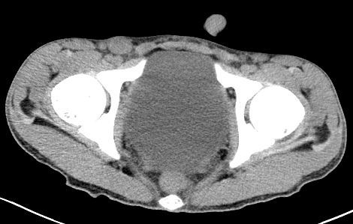
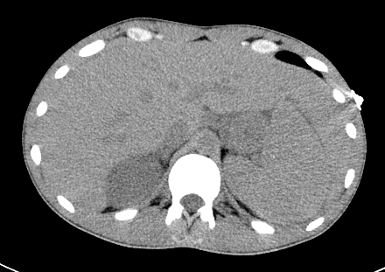
A Case of Macrophage Activating Syndrome Complicating New Onset Systemic Lupus Erythematosus
Yu, M.,Munankami, S., Pokhrel, A., Shrestha, M., Rijal, S., Basnet, S.
Department of Medicine, Tower Health, Reading Hospital
Macrophage activating syndrome (MAS) is a life-threatening disorder caused by inappropriate immune activation which may present as an acute febrile illness with lymphadenopathy, hepatosplenomegaly, and encephalopathy. Left untreated, MAS has a mortality of up to 50%² We present a case of MAS manifesting in the context of new-onset systemic lupus erythematosus (SLE).
IMAGES
INTRODUCTION
INCLUSION CRITERIA – HLH 2004 Trial¹
For diagnosis: Needing 5 out of 8 of the following:
A
B
Fever >38.5 C
Splenomegaly
Bicytopenia (2 or 3 cell lineages)
Ferritin >500 ug/L
Hypertriglyceridemia >2 mmol/L OR
Hypofibrinogenemia <1.5 g/dL
Bone marrow biopsy demonstrating hemophagocytosis
Low or Absent NK Cell Activity
Soluble CD25 (IL-2) >2400 U/mL
CASE DESCRIPTION
A 26-year-old male with a family history of SLE presented with 3 months of generalized weakness, myalgias, swelling in his fingers and toes, and an unintentional 30-lb weight loss. Vitals on admission were remarkable for a temperature of 38.5°C. Exam was significant for soft, non-tender bilateral axillary and inguinal lymph nodes.
Initial Laboratory Evaluation:
Ferritin: >7500 ng/mL (24 – 336)
Sedimentation Rate: 52 mm/hr (0 – 15)
D-dimer: 3425 FEUng/mL (0 – 500)
Triglycerides: 408 mg/dL (<175)
hs Troponin I: 103.1 pg/mL (0 – 19.8)
Subsequent right inguinal lymph node biopsy revealed reactive lymph node with follicular hyperplasia and broad areas of infarction without evidence of abnormal lymphoid cells on flow cytometry. A bone marrow biopsy showed normocellular marrow without evidence of hemophagocytosis or atypical lymphoid infiltrate. The diagnosis of MAS was made in the setting of fever, diffuse lymphadenopathy, splenomegaly, hypertriglyceridemia, pancytopenia, and elevated serum ferritin. He was started on intravenous methylprednisolone with marked clinical improvement and normalization of his inflammatory markers and was discharged with oral steroids and hydroxychloroquine.
Fig 1 CT Abdomen / Pelvis Without Contrast. Images A and B. Image A demonstrating an enlarged right inguinal lymph node, with short axis measuring 15 mm. Image B demonstrating marked hepatosplenomegaly.
DISCUSSION
This case demonstrates the importance of recognizing a life-threatening complication of new onset system lupus erythematosus. Macrophage activating syndrome is diagnosed when hemophagocytic lymphohistiocytosis presents in the context of a concurrent autoimmune disorder. This is most commonly systemic juvenile idiopathic arthritis.
MAS is a potentially lethal complication in patients with autoimmune disorders with over 50% mortality in untreated cases.
Early diagnosis is critical so that appropriate treatment with intravenous corticosteroids can be initiated to prevent tissue damage and death.
WBC 2.66 k/uL (3.85 – 10.15)
Hgb: 10 g/dL (13.3 – 16.2)
Platelet: 103 k/uL (160 – 400 )
AST: 440 IU/L (7 – 40)
ALT: 198 IU/L (10 – 60)
ALP 153 IU/L (60 – 350)
Albumin 2.5 g/dL (3.8 – 5.4)
Concurrent Rheumatologic Disorder
(ex. Systemic Juvenille Idiopathic Arthritis, Systemic Lupus Erythematosus)
REFERENCES
Bergsten E, Horne A, Aricó M, Astigarraga I, Egeler RM, Filipovich AH, Ishii E, Janka G, Ladisch S, Lehmberg K, McClain KL, Minkov M, Montgomery S, Nanduri V, Rosso D, Henter JI. Confirmed efficacy of etoposide and dexamethasone in HLH treatment: long-term results of the cooperative HLH-2004 study. Blood. 2017 Dec 21;130(25):2728-2738. doi: 10.1182/blood-2017-06-788349. Epub 2017 Sep 21. PMID: 28935695; PMCID: PMC5785801.
Lerkvaleekul B, Vilaiyuk S. Macrophage activation syndrome: early diagnosis is key. Open Access Rheumatol. 2018 Aug 31;10:117-128. doi: 10.2147/OARRR.S151013. PMID: 30214327; PMCID: PMC6124446.
MACROPHAGE ACTIVATING SYNDROME

